Slide 1

PREDICTION OF CONCRETE COMPREHENSIVE STRENGTH USING MACHINE LEARNING
SANJEEV KUMAR M
ISAI NATHAN s
RAGULSANKAR P

Slide 2
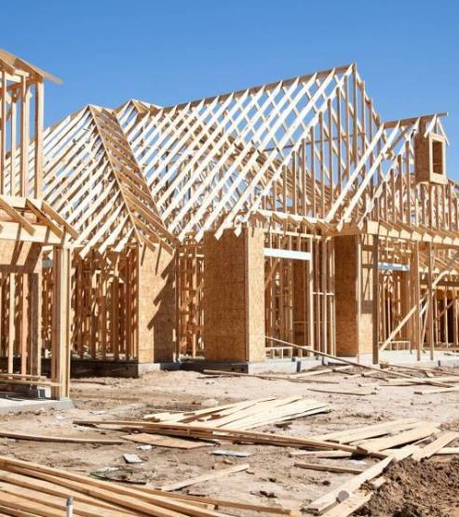

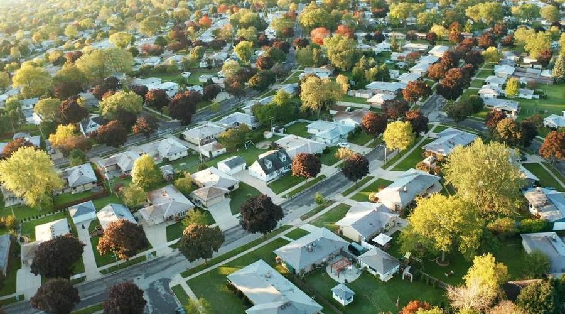
Agenda
Problem
Solution
Dataset
Preprocessing
Model creation
Flask frame work
Front end
Demo

Slide 3

Introduction
Concrete is the most important material in civil engineering. The concrete compressive strength is a highly nonlinear function of age and ingredients. These ingredients include cement, blast furnace slag, fly ash, water, superplasticizer, coarse aggregate, and fine aggregate . It is very difficult to Calculate the concrete comprehensive strength by Manually. With the help of machine learning , we predict the comprehensive strength with the given features .

Slide 4
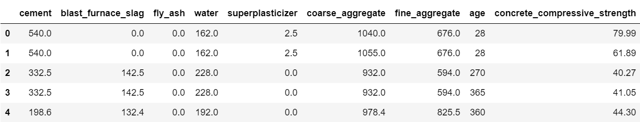
Table

Slide 5
Definition and Its Uses:
Cement - cement, in general, adhesive substances of all kinds, but, in a narrower sense, the binding materials used in building and civil engineering construction.
Blast Furnace - a large structure like an oven in which rock containing iron (iron ore) is melted in order to take out the metal and it is mainly used to smelt the iron from its ore
Slag - Slag is the silicon dioxide and metal oxide mixture left over as a by-product of extracting metal from its ore during the smelting process and it is used for Various applications like mass concrete, flatwork, concrete paving
Fly Ash - Fly ash is a byproduct of pulverised coal or coal dust in power generating plants and is being increasingly used as a substitute for cement in making bricks and it is used as a supplementary cementitious material (SCM)
Superplasticizers – It is known as high range water reducers, are additives used in making high strength concrete and it used to to create flowing, self-leveling concrete without increasing water, without reducing cement
Coarse Aggregate - Coarse aggregates are any particles greater than 0.19 inch, but generally range between 3/8 and 1.5 inches in diameter
Fine Aggregate - Fine aggregates generally consist of natural sand or crushed stone with most particles passing through a 3/8-inch sieve

Slide 6
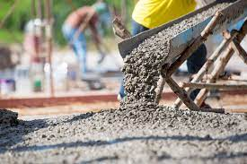
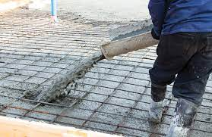
SOLUTION
BEING VERY HARD TO PREDICT THE CONCRETE STRENGTH MANUALLY , WE USE MACHINE LEARNING ALGORITHM FOR PREDICTION.
FOR OUR DATASET WE CHOOSE RANDOM FOREST REGRESSOR MACHINE LEARNING ALGORITHM FOR PREDICTION AND GIVES THE ACCURACY AROUND THE 90%.
SO IT REDUCES WORKLOAD & GIVES THE ACCURATE VALUE FOR THE CIVIL ENGINEERS TO KNOW (HOW STRONG OUR CONCRETE IS?) WITH THEIR AMOUNT OF INGREDIENTS

Slide 7
Timeline
DATASET
The dataset is taken from the Kaggle platform
PREPROCESS&ANALYZE
Convert the dataset into a dataframe using pandas. And preprocess the dataset .Analye the dataset using some data visualization libraries
MODEL
We use random forest regressor algorithm . And trained and tested the algorithm using our dataset . And optimize the model better accuracy
FLASK
We created the framework using flask .To give the new input values to
Machine learning model
FRONTEND
Created the simple html page using html. To get the input values from the user

Slide 8




Thank you
Sanjeev kumar m | isai nathan s| ragulsankar P

